Slide 1


Slide 2

All input and output is performed with streams, which are sequences of bytes.
In input operations, the bytes flow from a device (e.g., a keyboard, a disk drive, a network connection) to main memory.
In output operations, bytes flow from main memory to a device (e.g., a display screen, a printer, a disk drive, a network connection, and so on).
When program execution begins, three streams are connected to the program automatically.

Slide 3

Normally, the standard input stream is connected to the keyboard and the standard output stream is connected to the screen.
Operating systems often allow these streams to be redirected to other devices.
A third stream, the standard error stream, is connected to the screen.
Error messages are output to the standard error stream.

Slide 4

Precise output formatting is accomplished with printf.
Every printf call contains a format control string that describes the output format.
The format control string consists of conversion specifiers, flags, field widths, precisions and literal characters.
Together with the percent sign (%), these form conversion specifications.

Slide 5

Printf can perform the following formatting capabilities:
  Rounding floating-point values to an indicated number of decimal places.
  Aligning a column of numbers with decimal points appearing one above the other.
  Right justification and left justification of outputs.
  Inserting literal characters at precise locations in a line of output.
  Representing floating-point numbers in exponential format.
  Representing unsigned integers in octal and hexadecimal format
  Displaying all types of data with fixed-size field widths and precisions.

Slide 6
The printf function has the form
    printf(“Format Specifier”, var1, var2, …., varn);
Format Specifier describes the output format.
Each conversion specification begins with a percent sign and ends with a conversion specifier.
There can be many conversion specifications in one format control string.

Slide 7

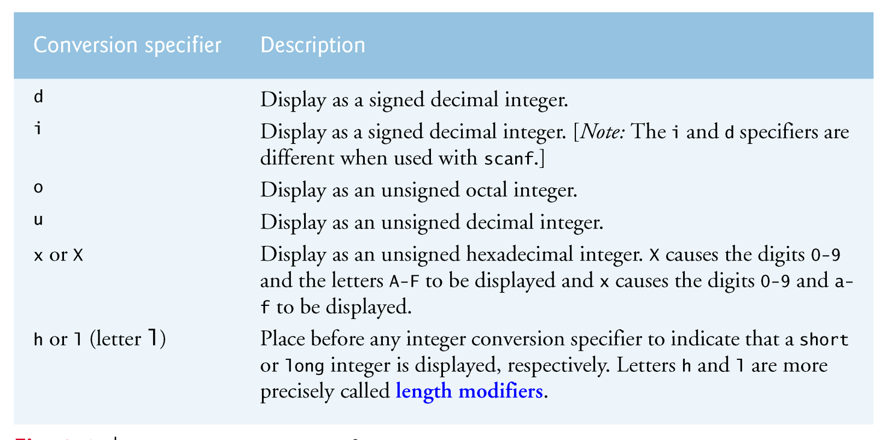
An integer is a whole number, such as 776, 0 or –52, that contains no decimal point.
Integer values are displayed in one of several formats.

Slide 8

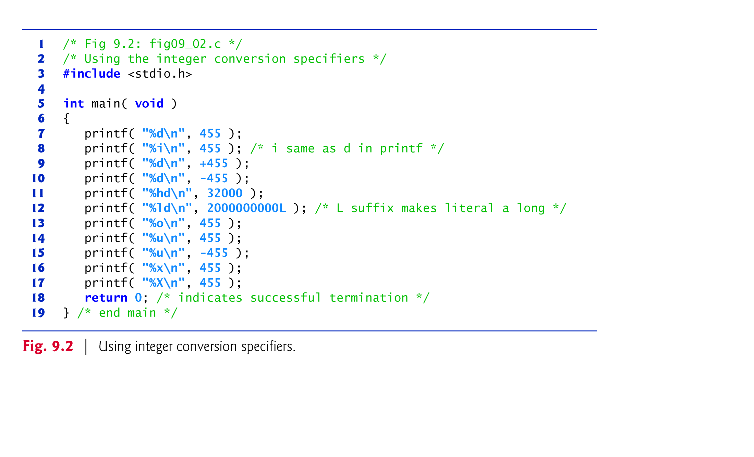

Slide 9
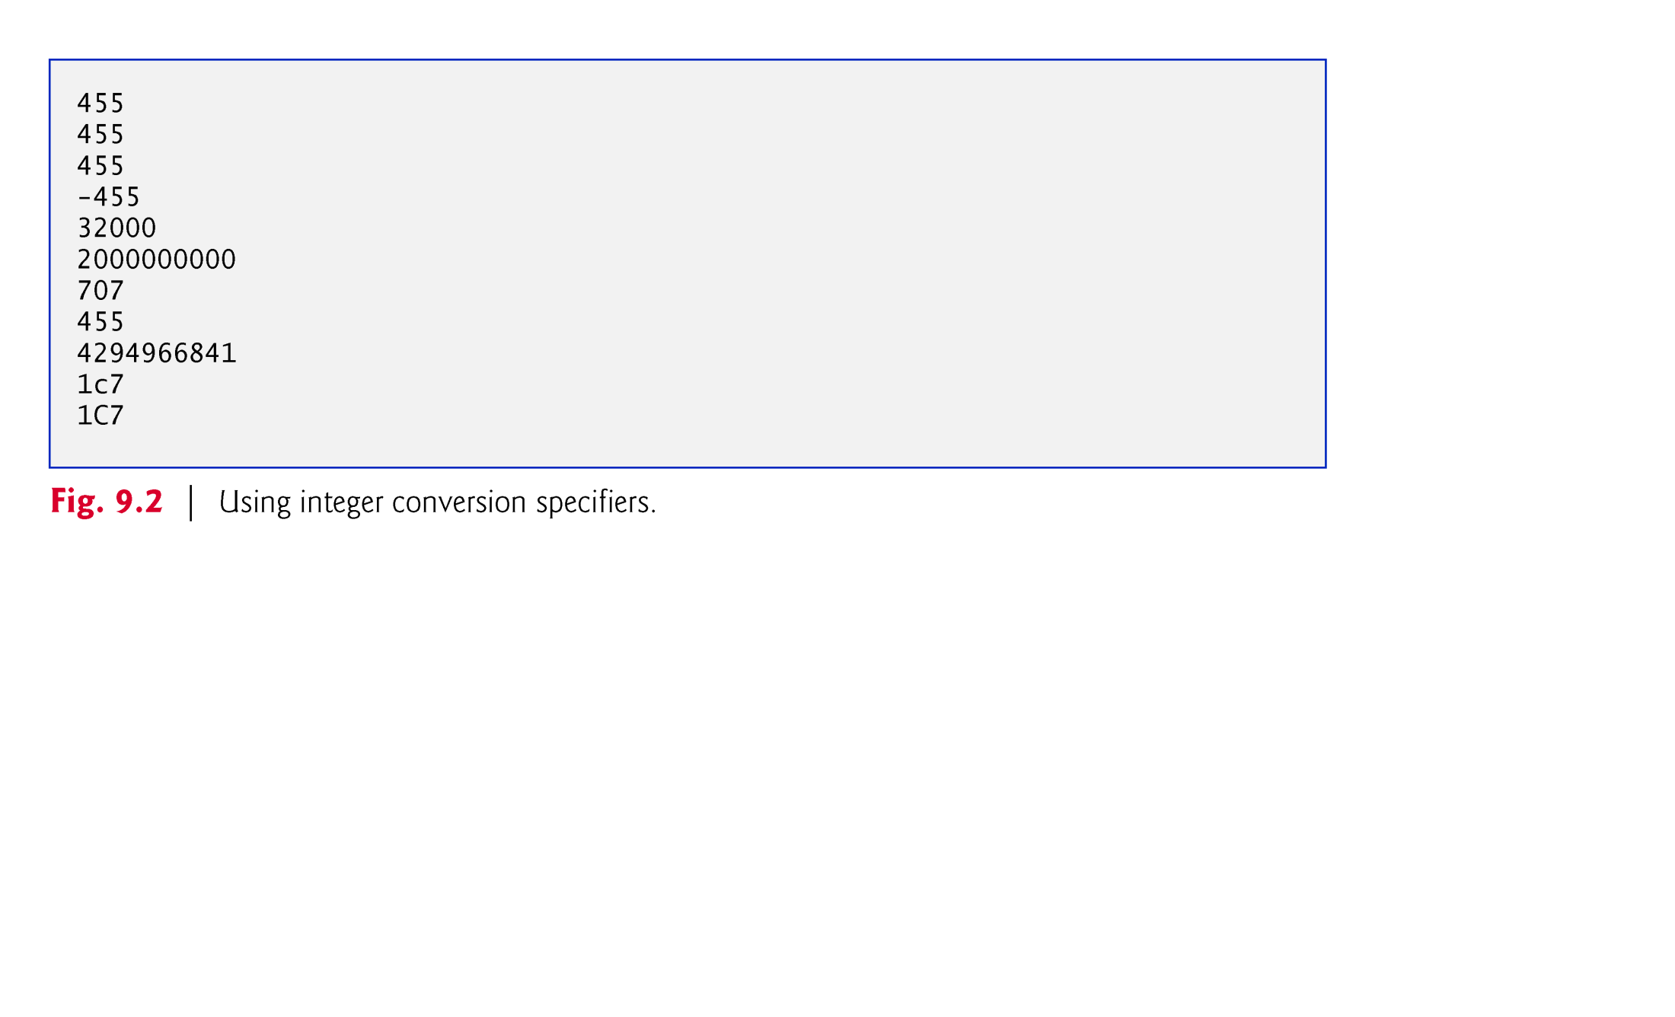

Slide 10

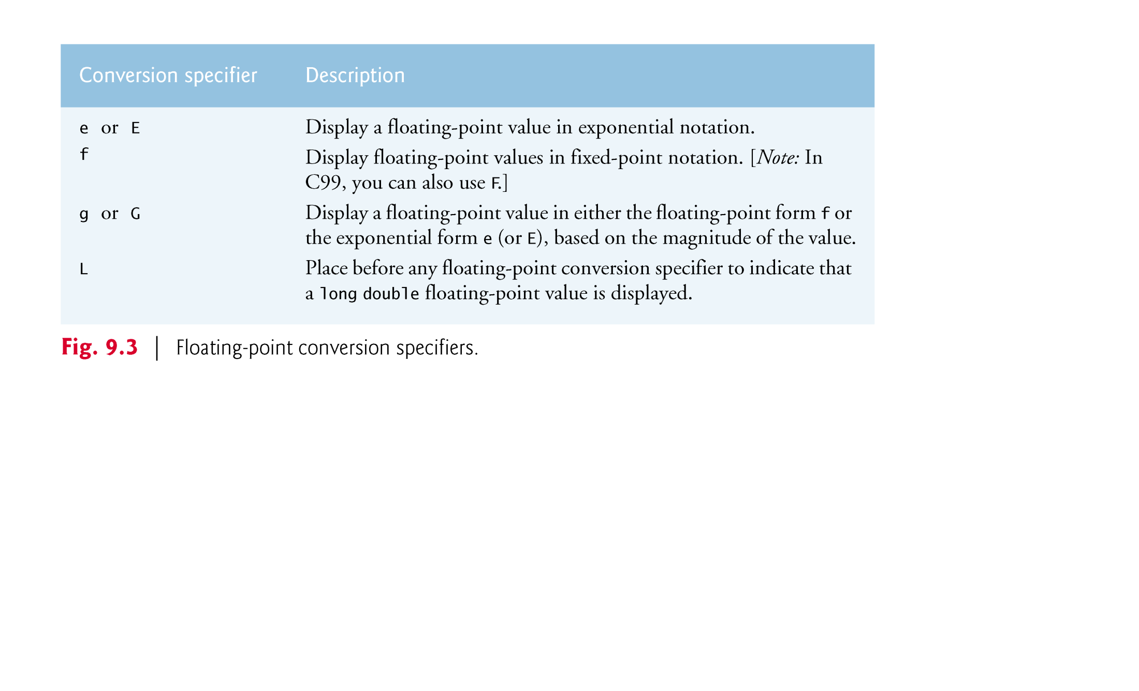
A floating-point value contains a decimal point as in 33.5, 0.0 or -657.983.
The conversion specifiers e and E display floating-point values in exponential notation—the computer equivalent of scientific notation used in mathematics.

Slide 11

For example, the value 150.4582 is represented in scientific notation as::
    1.504582 × 10²
and is represented in exponential notation as
    1.504582E+02
This notation indicates that 1.504582 is multiplied by 10 raised to the second power (E+02).
The E stands for “exponent.”

Slide 12
Values displayed with e, E and f show six digits of precision to the right of the decimal point by default (e.g., 1.04592); other precisions can be specified explicitly.
Conversion specifiers e and E print lowercase e and uppercase E, respectively, preceding the exponent, and print exactly one digit to the left of the decimal point.
Conversion specifier g (or G) prints in either e (E) or f format with no trailing zeros (1.234000 is printed as 1.234).
Values are printed with e (E) if, after conversion to exponential notation, the value’s exponent is less than -4, or the exponent is greater than or equal to the specified precision (six significant digits by default for g and G). Otherwise, conversion specifier f is used to print the value.
At least one decimal digit is required for the decimal point to be output.

Slide 13

0.0000875, 8750000.0, 8.75, 87.50 and 875 are printed as …. with conversion specifier g??
0.0000875 uses e notation because, when it’s converted to exponential notation, its exponent (-5) is less than -4.
The value 8750000.0 uses e notation because its exponent (6) is equal to the default precision.
8.75e-05
8.75e+06
8.75, 87.5
875

Slide 14
The difference between g and G is identical to the difference between e and E when the value is printed in exponential notation—lowercase g causes a lowercase e to be output, and uppercase G causes an uppercase E to be output.
The %E, %e and %g conversion specifiers cause the value to be rounded in the output and the conversion specifier %f does not.
With some compilers, the exponent in the outputs will be shown with two digits to the right of the + sign.

Slide 15
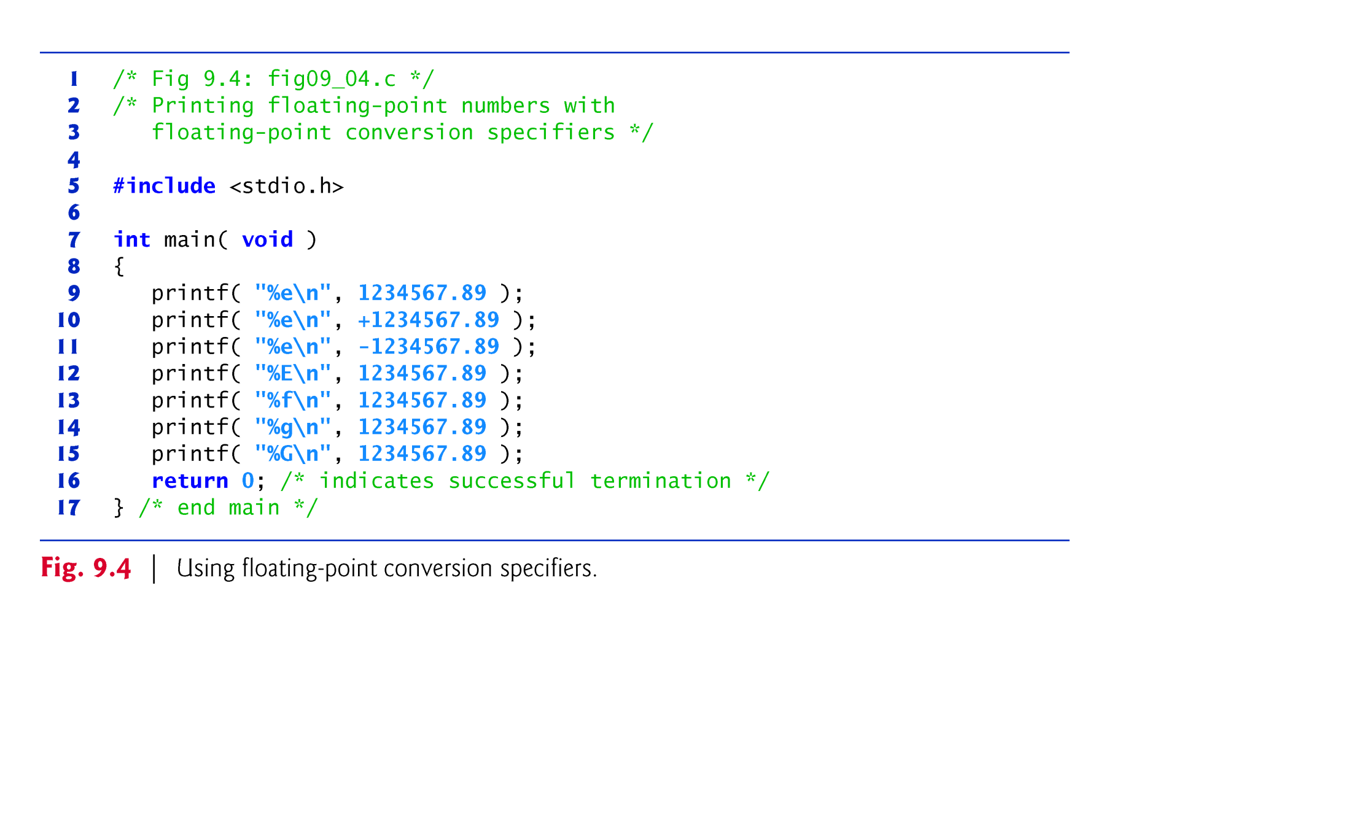

Slide 16
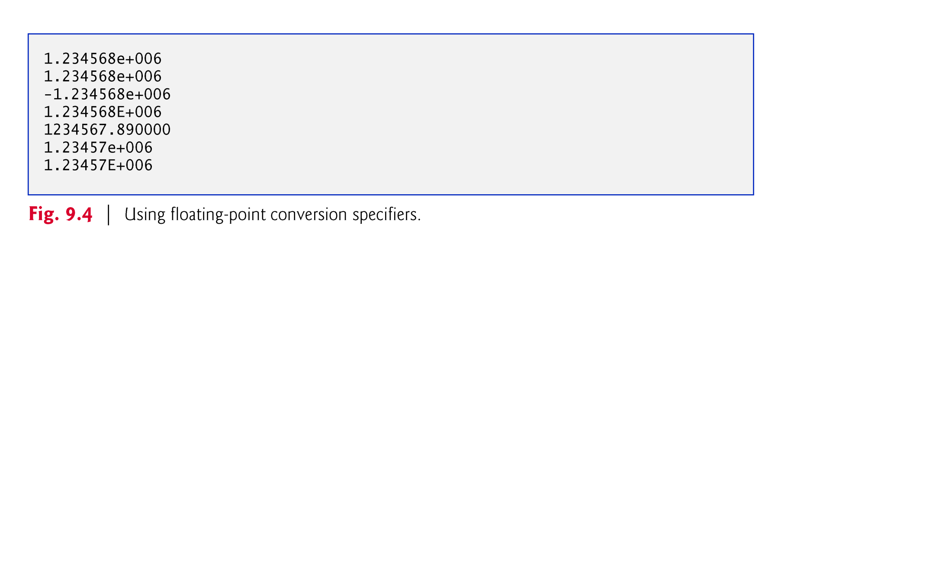

Slide 17

The c and s conversion specifiers are used to print individual characters and strings, respectively.
Conversion specifier c requires a char argument.
Conversion specifier s requires a pointer to char as an argument.
Conversion specifier s causes characters to be printed until a terminating null ('\0') character is encountered.

Slide 18
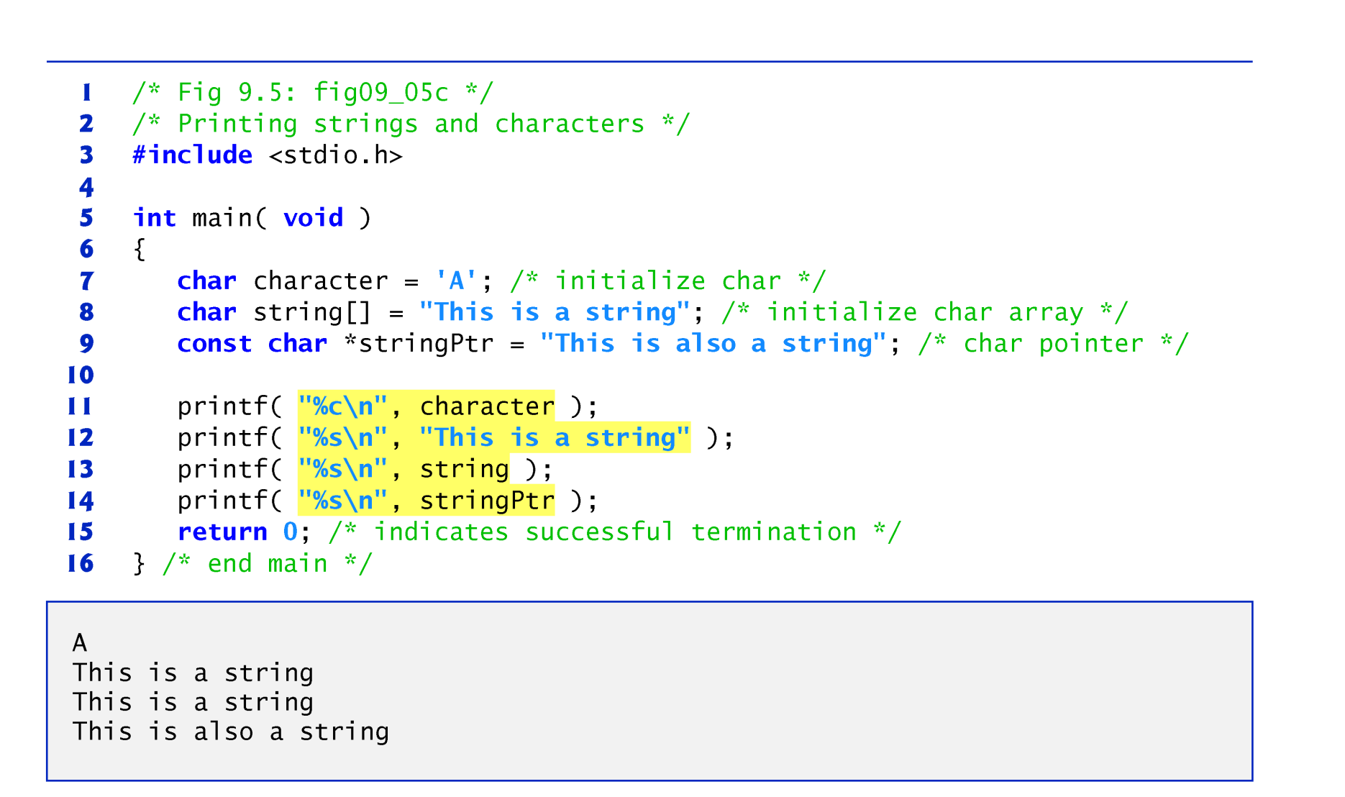

Slide 19

The exact size of a field in which data is printed is specified by a field width.
If the field width is larger than the data being printed, the data will normally be right justified within that field.
An integer representing the field width is inserted between the percent sign (%) and the conversion specifier (e.g., %4d).
The field width is increased to print values wider than the field and that the minus sign for a negative value uses one character position in the field width.
Field widths can be used with all conversion specifiers.

Slide 20
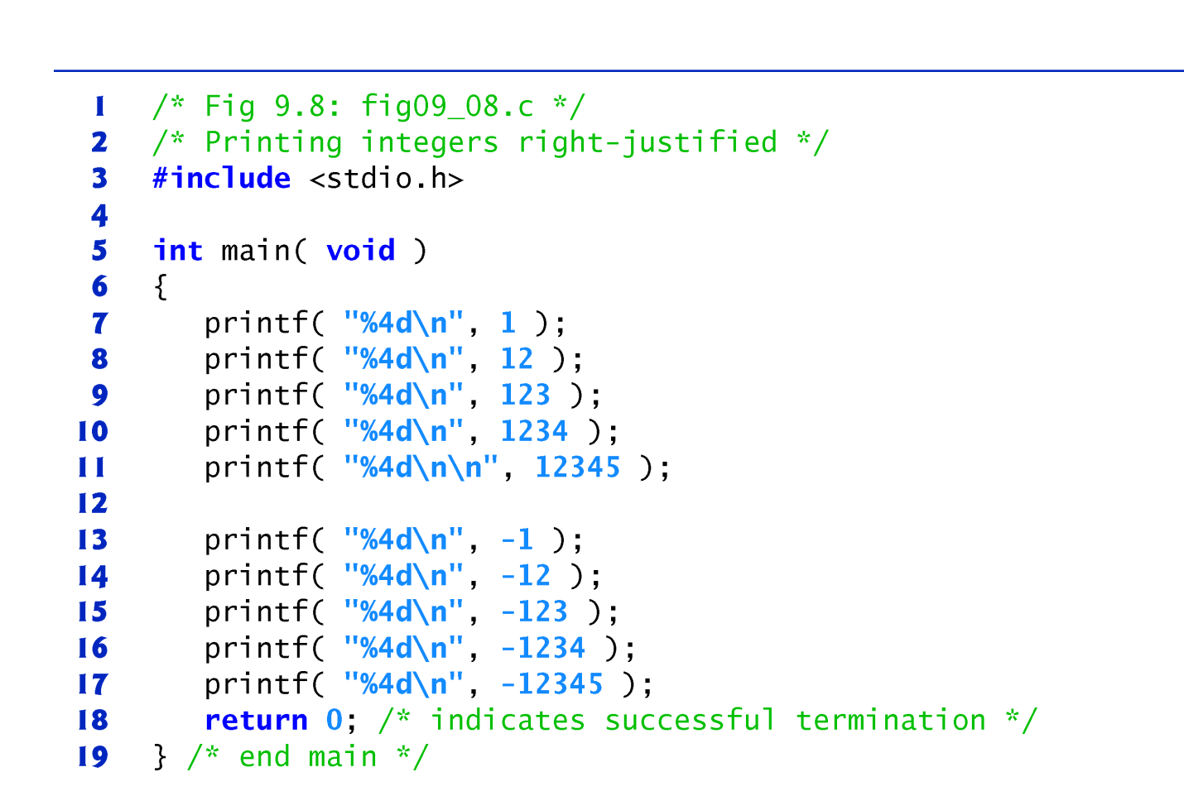
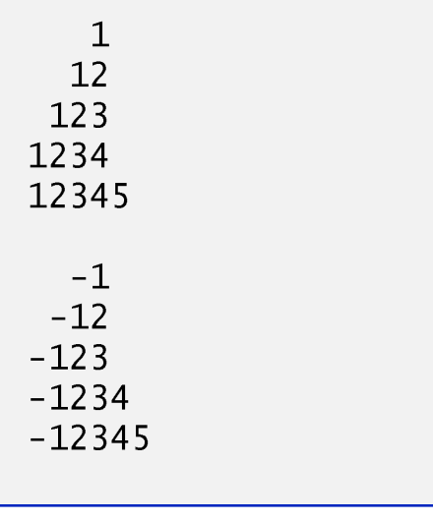

Slide 21

Function printf also enables you to specify the precision with which data is printed.
Precision has different meanings for different data types.
When used with integer conversion specifiers, precision indicates the minimum number of digits to be printed.
If the printed value contains fewer digits than the specified precision and the precision value has a leading zero or decimal point, zeros are prefixed to the printed value until the total number of digits is equivalent to the precision.
If neither a zero nor a decimal point is present in the precision value, spaces are inserted instead.

Slide 22
The default precision for integers is 1.
When used with floating-point conversion specifiers e, E and f, the precision is the number of digits to appear after the decimal point.
When used with conversion specifiers g and G, the precision is the maximum number of significant digits to be printed.
When used with conversion specifier s, the precision is the maximum number of characters to be written from the string.
To use precision, place a decimal point (.), followed by an integer representing the precision between the percent sign and the conversion specifier.

Slide 23
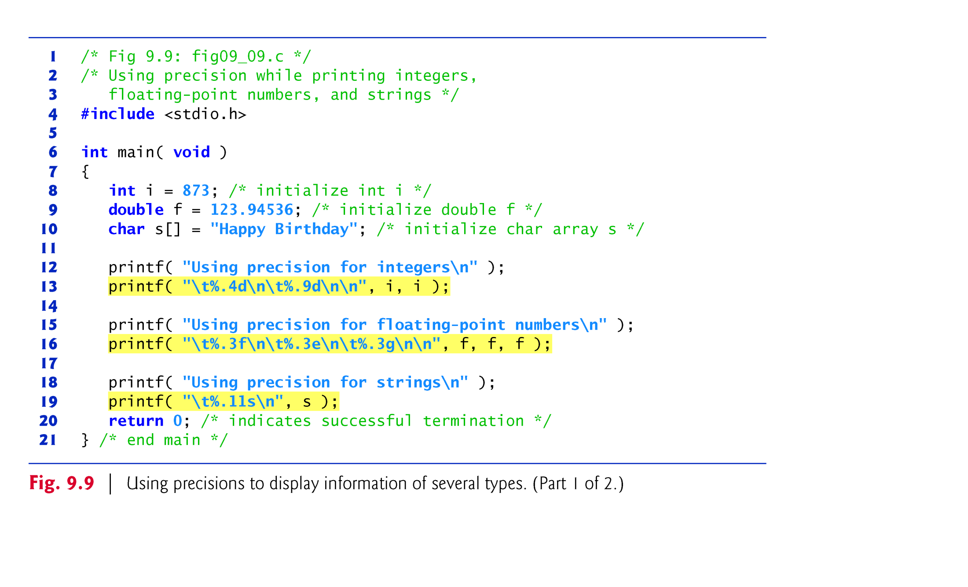
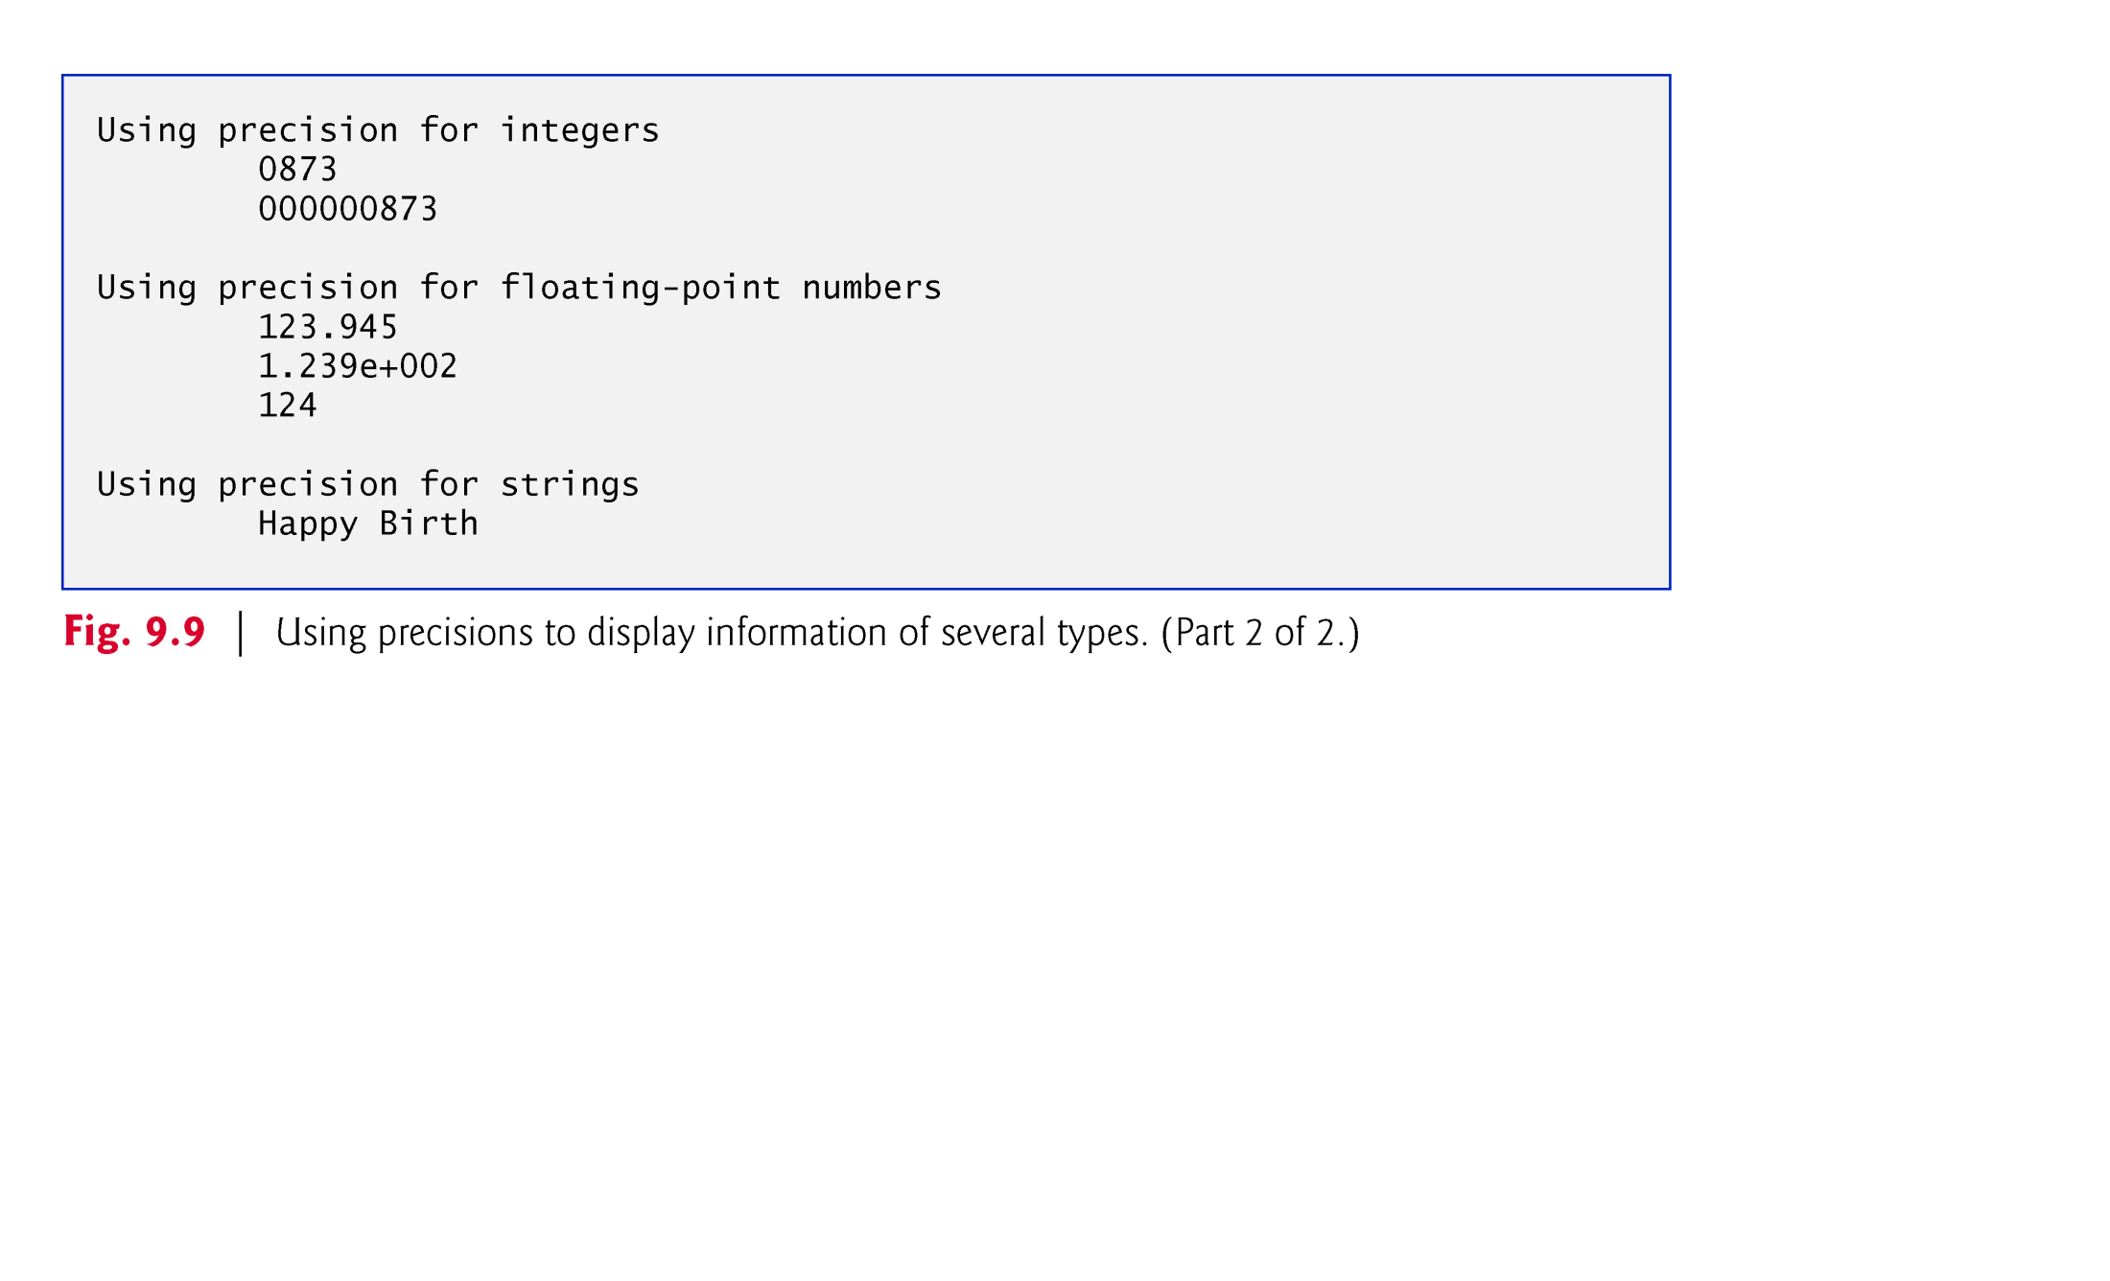
When a floating-point value is printed with a precision smaller than the original number of decimal places in the value, the value is rounded.

Slide 24
The field width and the precision can be combined by placing the field width, followed by a decimal point, followed by a precision between the percent sign and the conversion specifier, as in the statement
    printf( "%9.3f", 123.456789 );
which displays 123.457 with three digits to the right of the decimal point right justified in a nine-digit field.
It’s possible to specify the field width and the precision using integer expressions in the argument list following the format control string.

Slide 25
To use this feature, insert an asterisk (*) in place of the field width or precision (or both).
The matching int argument in the argument list is evaluated and used in place of the asterisk.
A field width’s value may be either positive or negative (which causes the output to be left justified in the field as described in the next section).
The statement
    printf( "%*.*f", 7, 2, 98.736 );
uses 7 for the field width, 2 for the precision and outputs the value 98.74 right justified.

Slide 26

Most literal characters to be printed in a printf statement can simply be included in the format control string.
However, there are several “problem” characters, such as the quotation mark (") that delimits the format control string itself.
Various control characters, such as newline and tab, must be represented by escape sequences.
An escape sequence is represented by a backslash (\), followed by a particular escape character.
Figure 9.16 lists the escape sequences and the actions they cause.

Slide 27
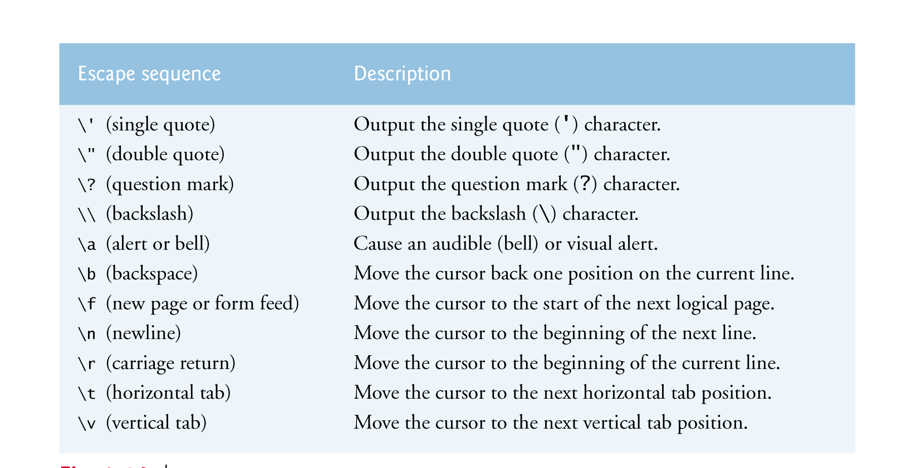

Slide 28

Precise input formatting can be accomplished with scanf.
Every scanf statement contains a format control string that describes the format of the data to be input.
The format control string consists of conversion specifiers and literal characters.
Function scanf has the following input formatting capabilities:
  Inputting all types of data.
  Inputting specific characters from an input stream.
  Skipping specific characters in the input stream.

Slide 29

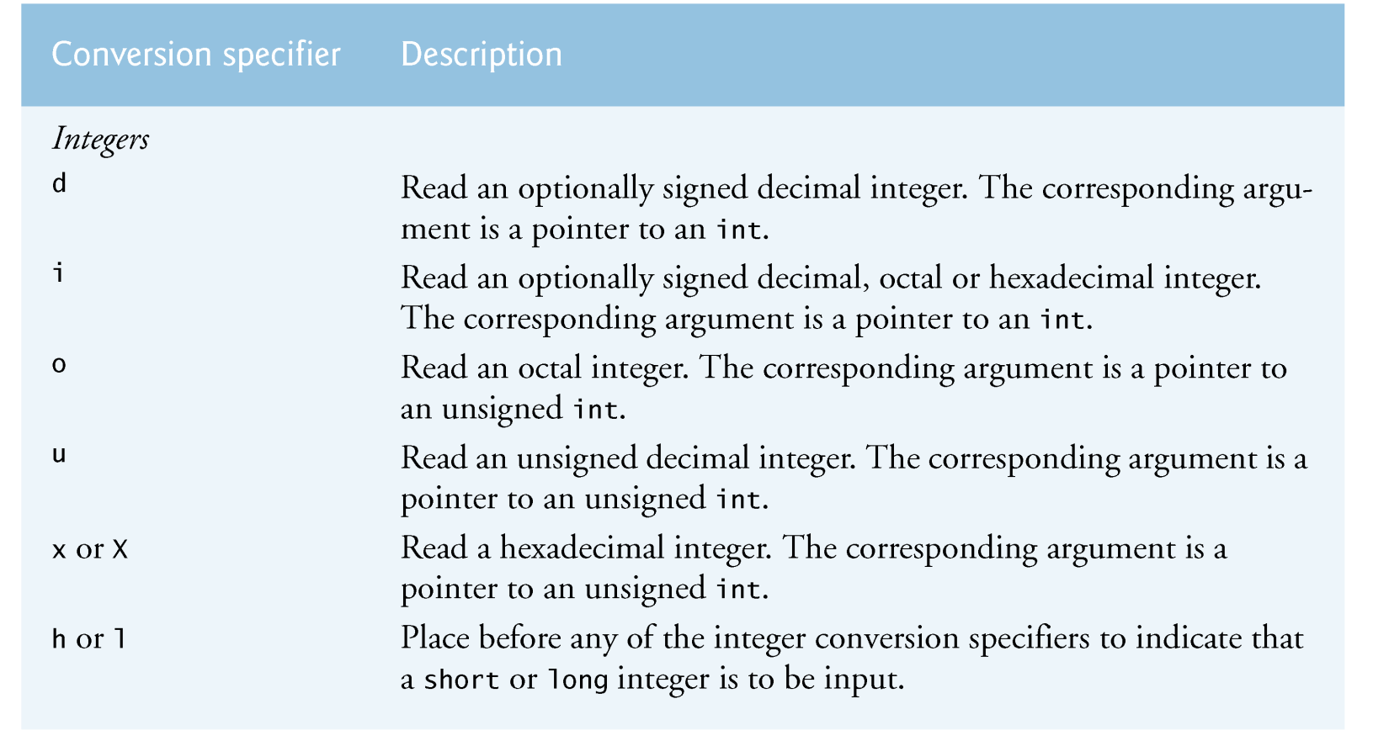
Function scanf is written in the following form:
    scanf( format-control-string, other-arguments );
format-control-string describes the formats of the input, and other-arguments are pointers to variables in which the input will be stored.

Slide 30
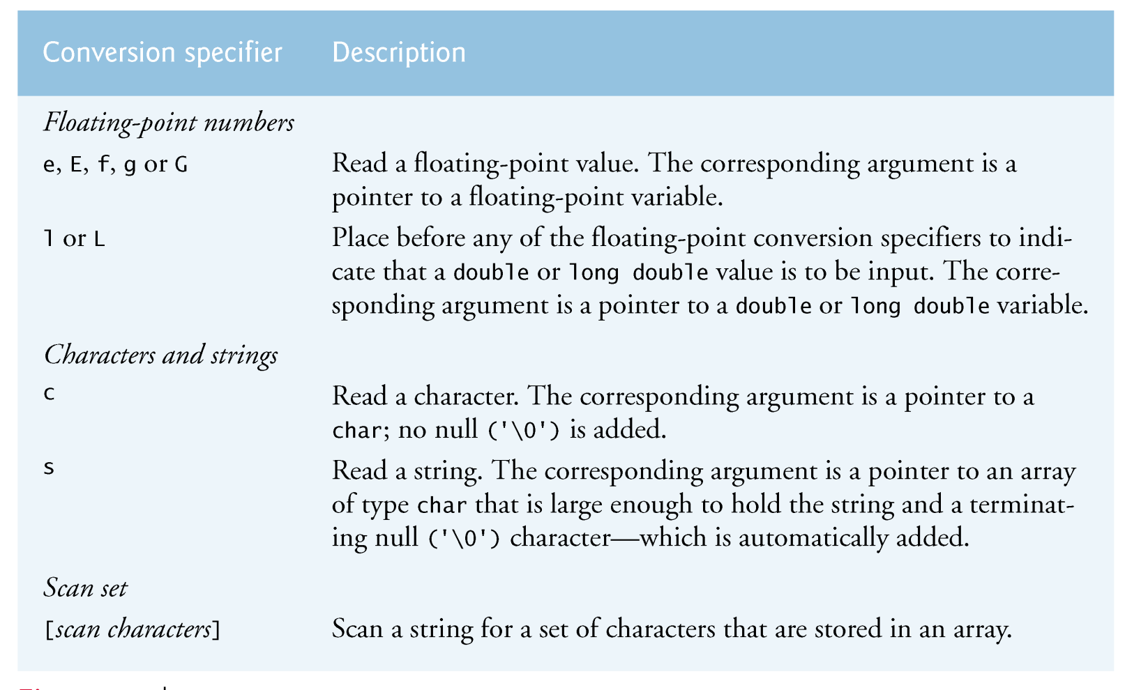

Slide 31
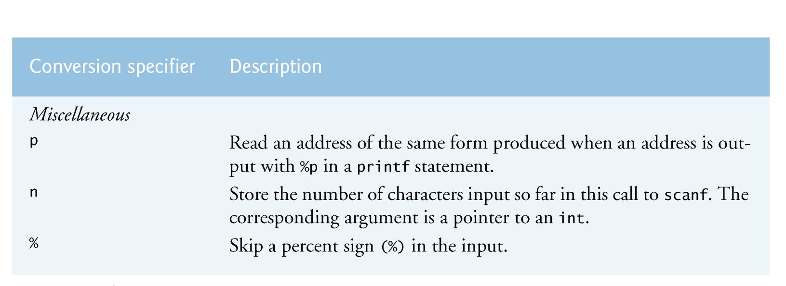

Slide 32
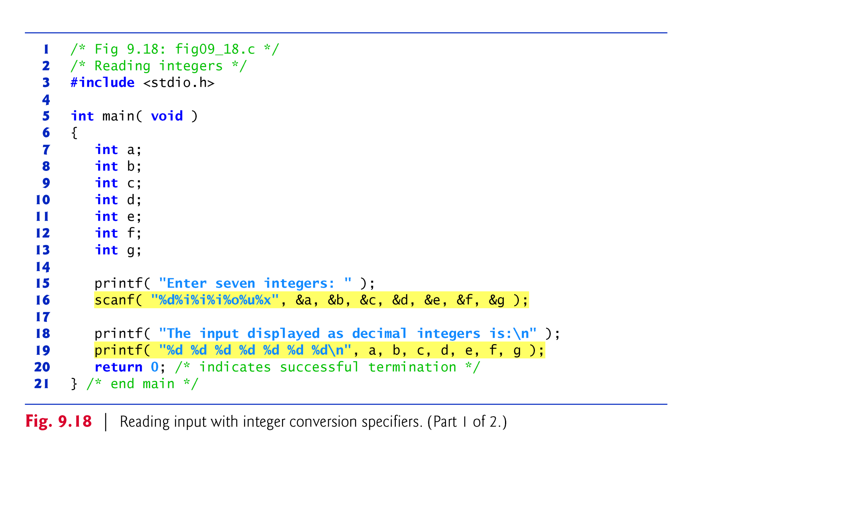
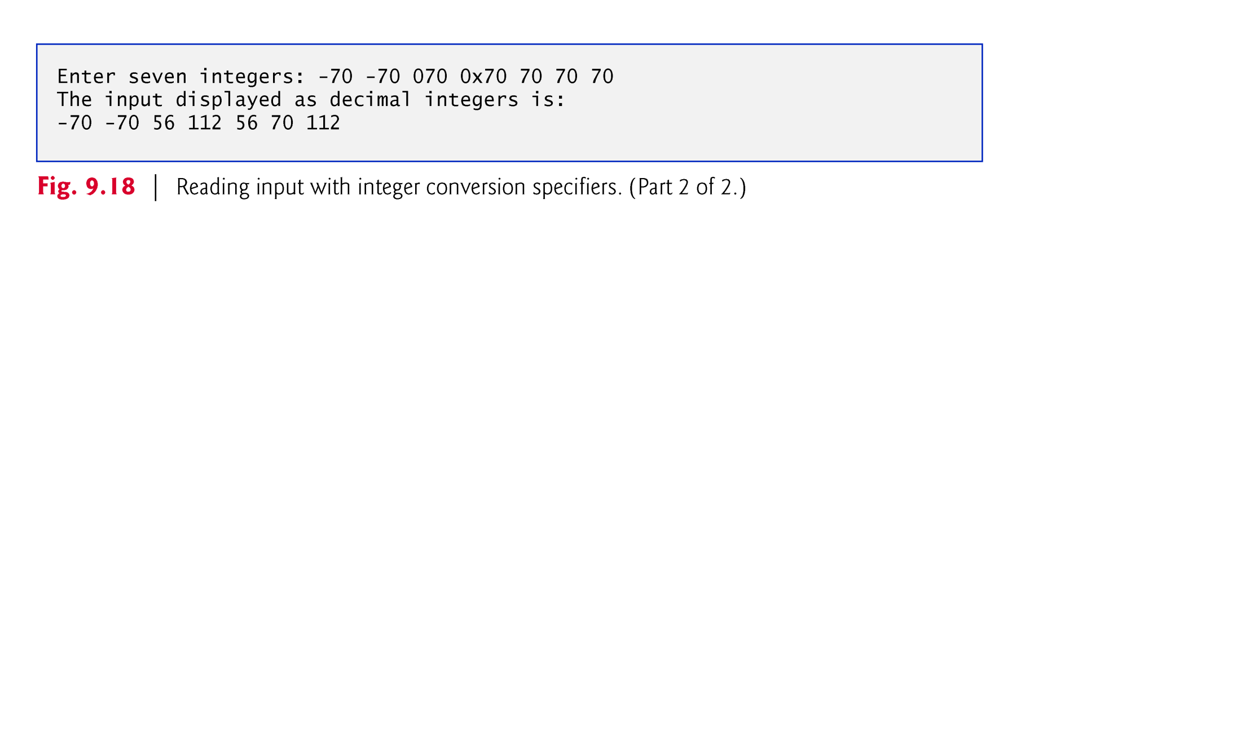
Conversion specifier %i is capable of inputting decimal, octal and hexadecimal integers.

Slide 33
When inputting floating-point numbers, any of the floating-point conversion specifiers e, E, f, g or G can be used.
Figure 9.19 reads three floating-point numbers, one with each of the three types of floating conversion specifiers, and displays all three numbers with conversion specifier f.
The program output confirms the fact that floating-point values are imprecise—this is highlighted by the third value printed.

Slide 34
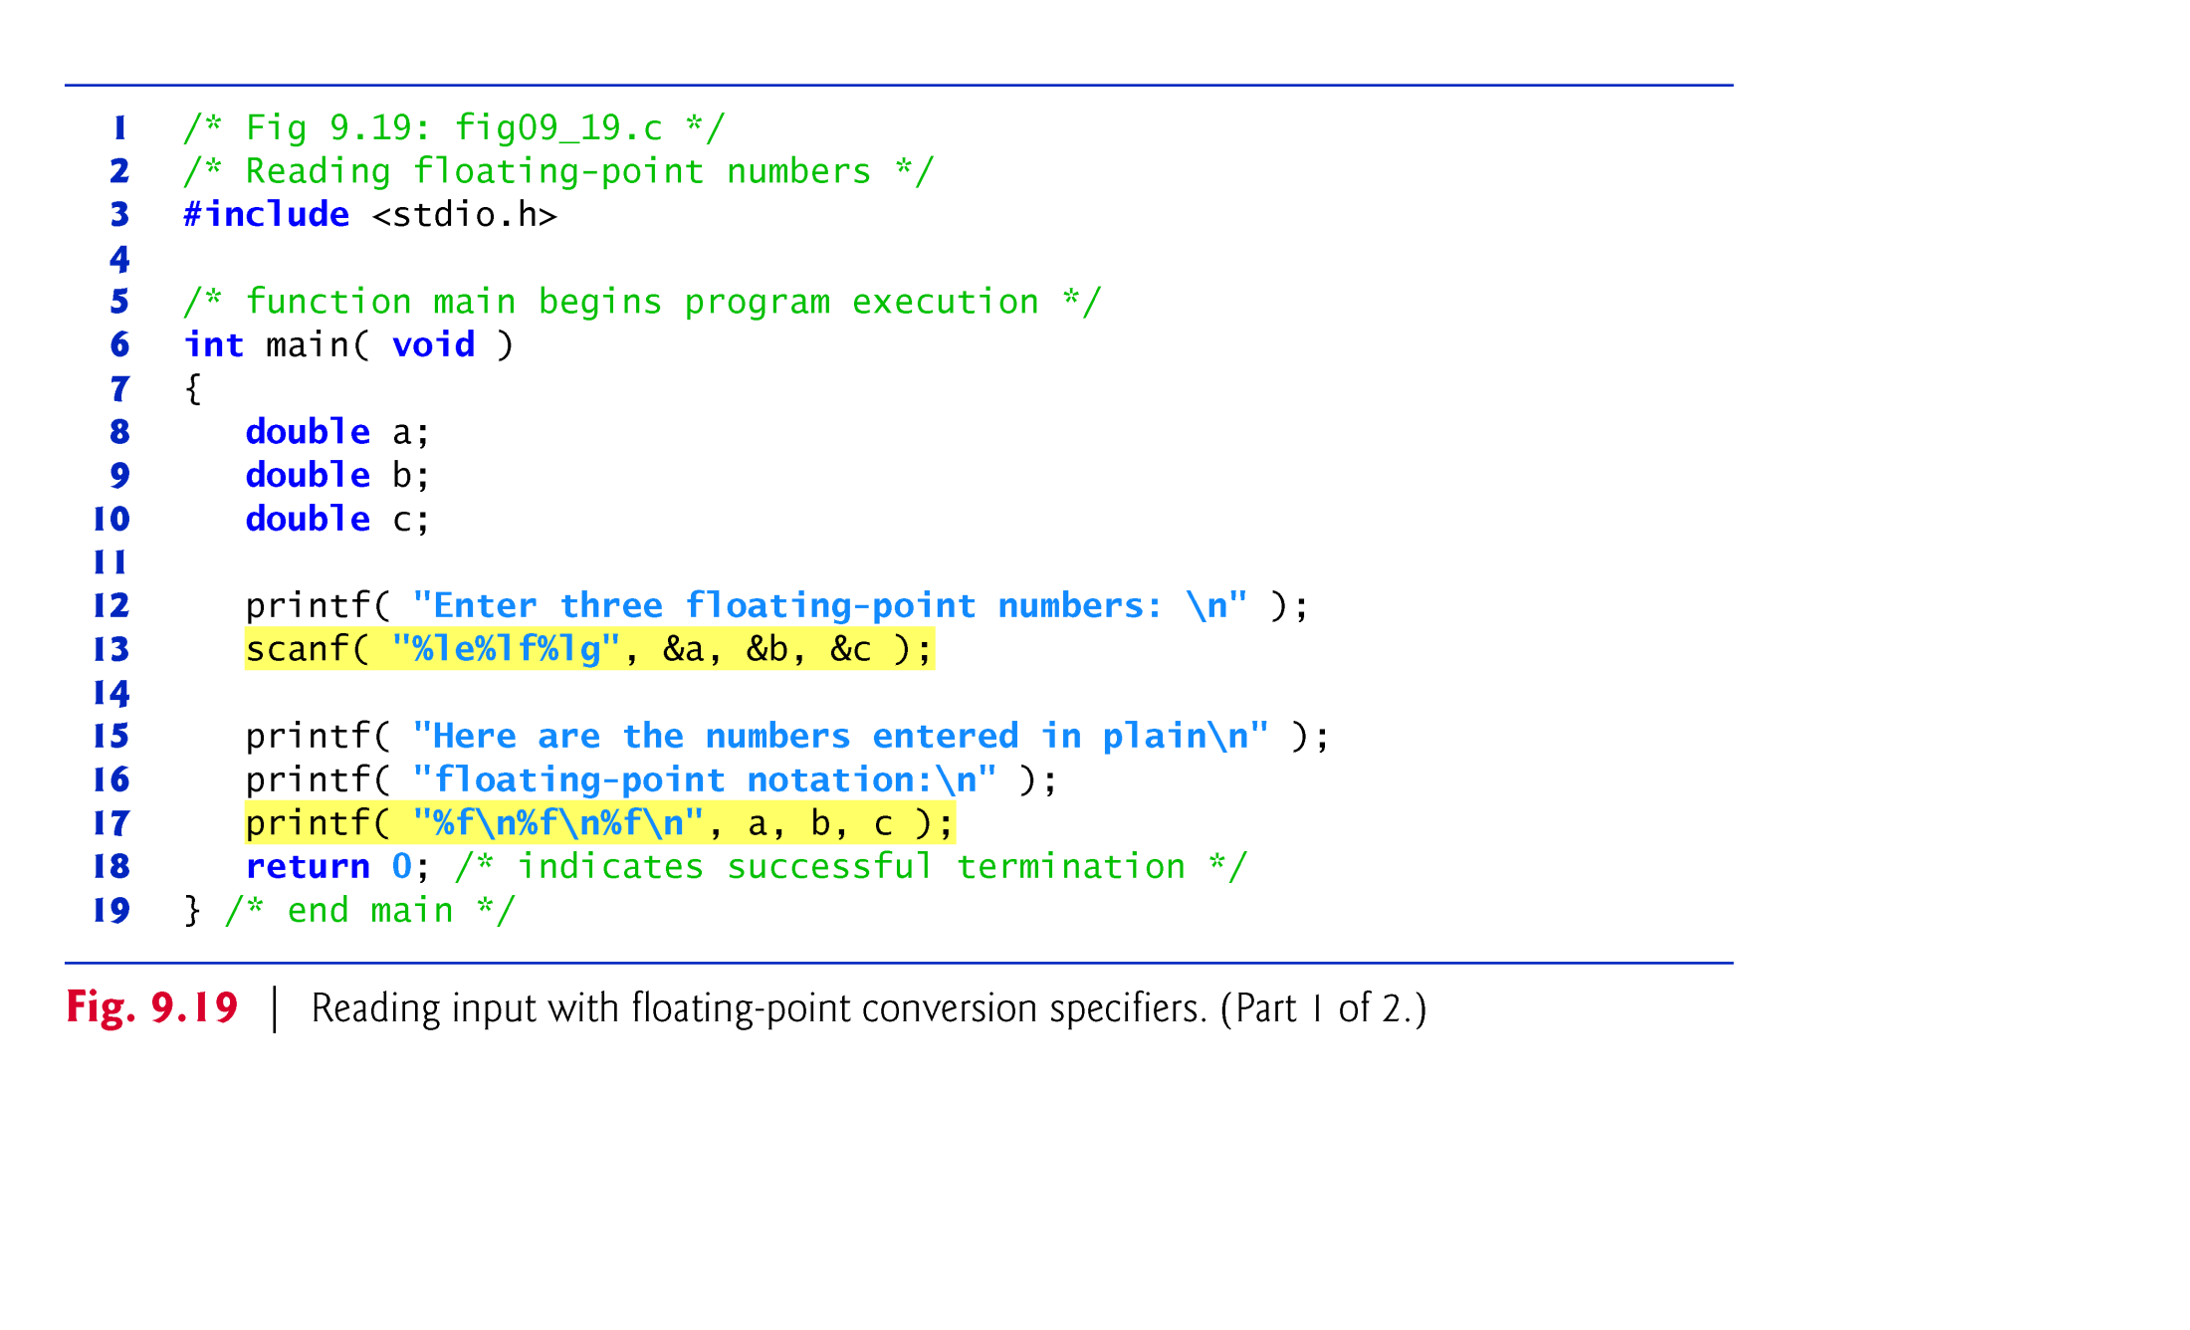
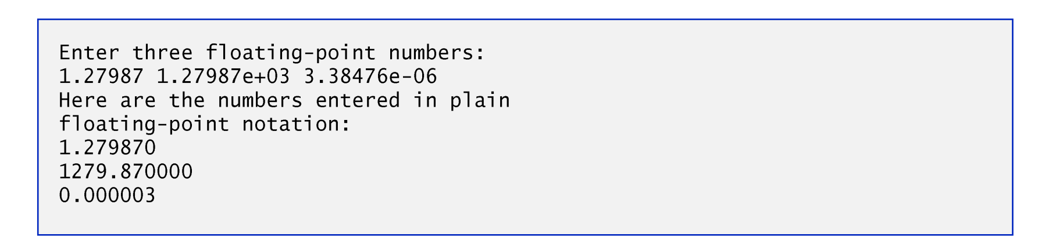

Slide 35
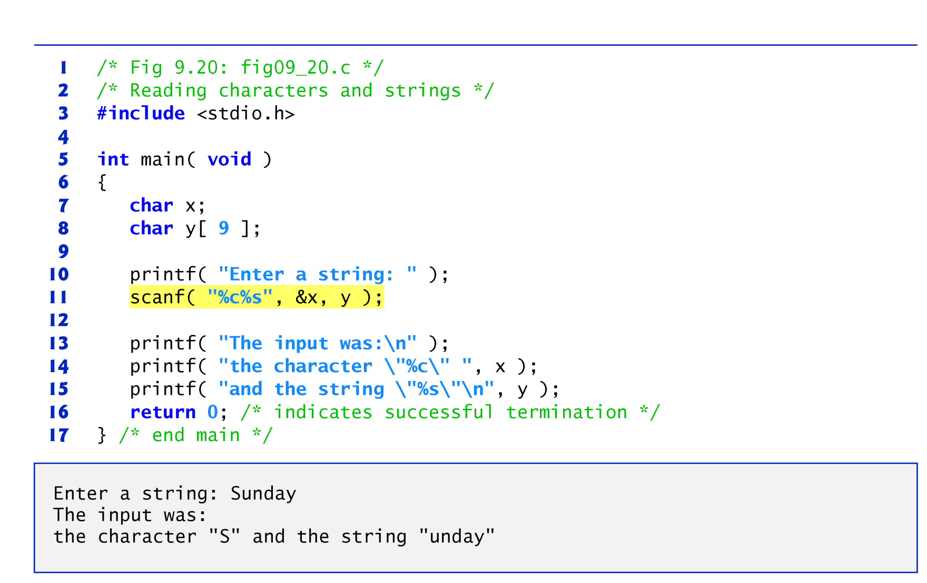
Characters and strings are input using the conversion specifiers c and s, respectively. The program inputs the first character of the string with %c and stores it in the character variable x, then inputs the remainder of the string with %s and stores it in character array y.

Slide 36
A sequence of characters can be input using a scan set.
A scan set is a set of characters enclosed in square brackets, [], and preceded by a percent sign in the format control string.
A scan set scans the characters in the input stream, looking only for those characters that match characters contained in the scan set.
Each time a character is matched, it’s stored in the scan set’s corresponding argument—a pointer to a character array.
The scan set stops inputting characters when a character that is not contained in the scan set is encountered.

Slide 37
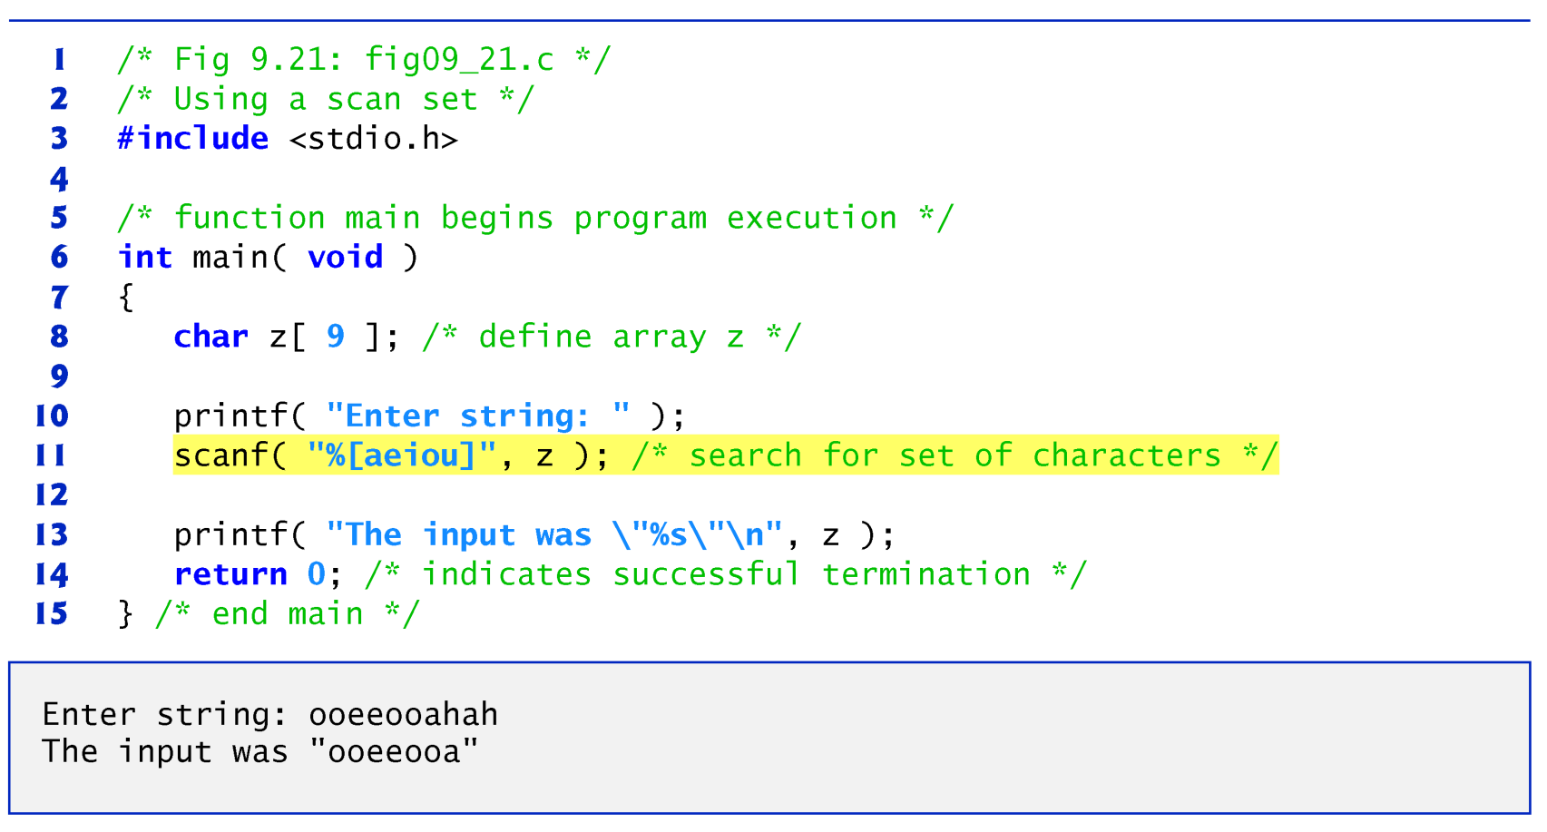
If the first character in the input stream does not match a character in the scan set, only the null character is stored in the array.

Slide 38
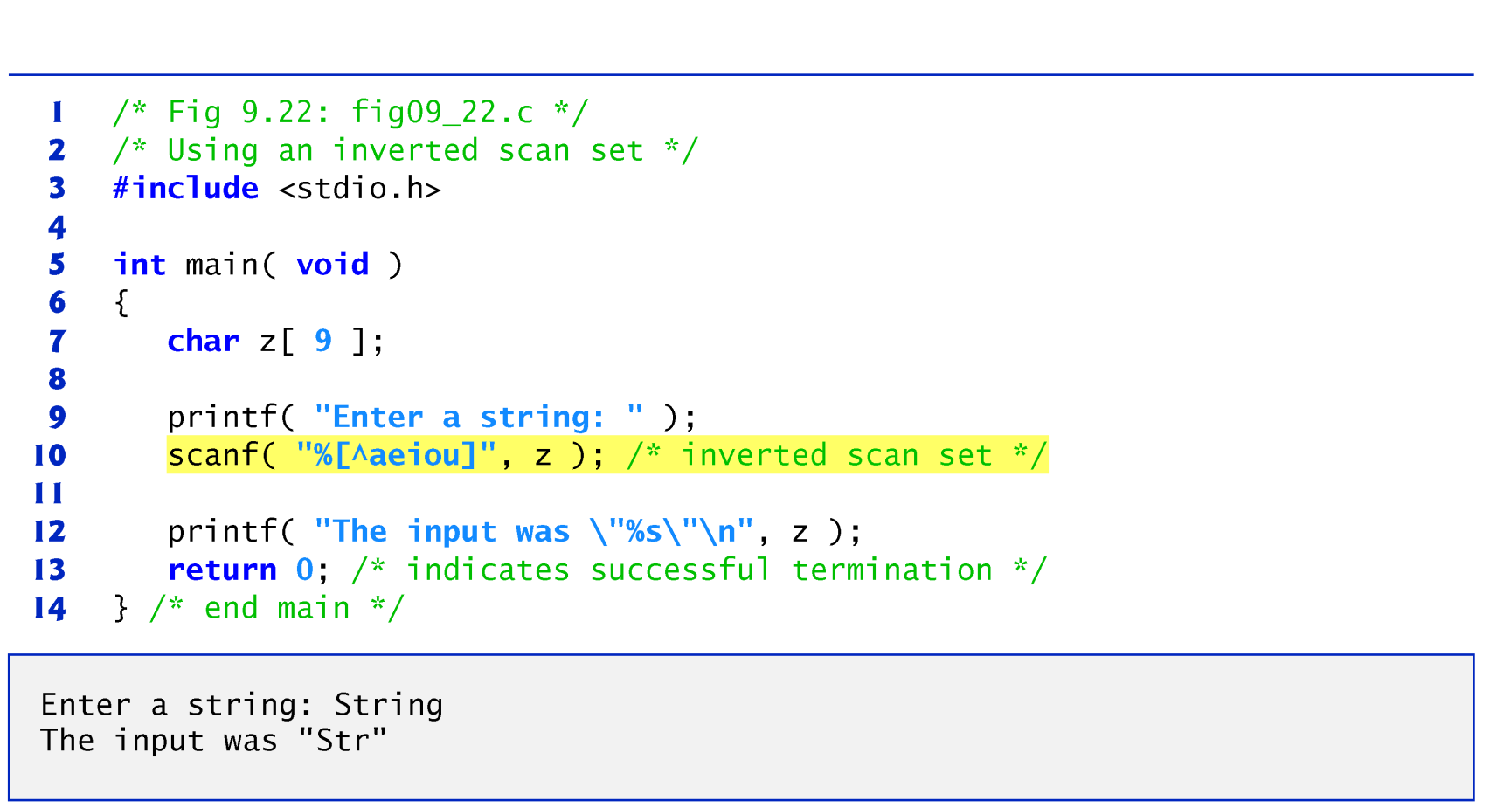
The scan set can also be used to scan for characters not contained in the scan set by using an inverted scan set. For this, place a caret (^) in the square brackets before the scan characters.
When a character contained in the inverted scan set is encountered, input terminates.

Slide 39
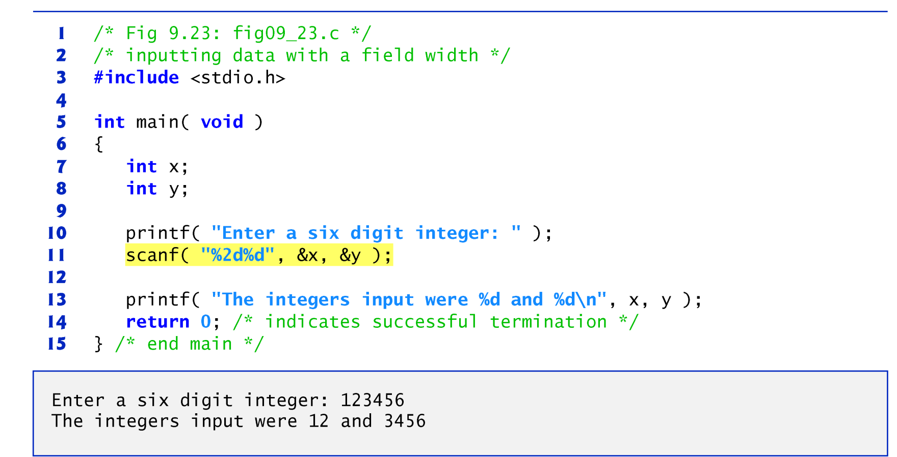
A field width can be used in a scanf conversion specifier to read a specific number of characters from the input stream.

Slide 40
Often it’s necessary to skip certain characters in the input stream.
For example, a date could be entered as
    11-10-1999
Each number in the date needs to be stored, but the dashes that separate the numbers can be discarded.
To eliminate unnecessary characters, include them in the format control string of scanf (white-space characters—such as space, newline and tab—skip all leading white-space).

Slide 41
For example, to skip the dashes in the input, use the statement
    scanf( "%d-%d-%d", &month, &day, &year );
Although, this scanf does eliminate the dashes in the preceding input, it’s possible that the date could be entered as
    10/11/1999
In this case, the preceding scanf would not eliminate the unnecessary characters.
For this reason, scanf provides the assignment suppression character *.

Slide 42

The assignment suppression character enables scanf to read any type of data from the input and discard it without assigning it to a variable.
Figure 9.24 uses the assignment suppression character in the %c conversion specifier to indicate that a character appearing in the input stream should be read and discarded.
Only the month, day and year are stored.
The argument lists for each scanf call do not contain variables for the conversion specifiers that use the assignment suppression character.
The corresponding characters are simply discarded.

Slide 43
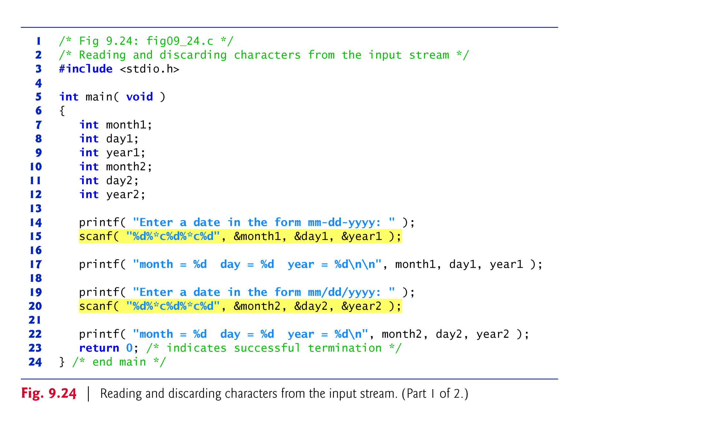

Slide 44
